Slide 1

AWS
INTRODUCTION TO MACHINE LEARNING

Slide 2
REVIEW OF LINEAR ALGEBRA FOR MACHINE LEARNING
Basics :
Scalars: Single values, denoted as lowercase letters (e.g., aaa).
Vectors: Ordered lists of numbers (e.g., features in data), denoted as bold lowercase (e.g., v\mathbf{v}v).
Matrices: 2D arrays of numbers (e.g., datasets with rows and columns), denoted as bold uppercase (e.g., A\mathbf{A}A).
Tensors: Generalizations of matrices to higher dimensions (common in deep learning).
2. Key Operations :
Addition/Subtraction: Element-wise for same-sized matrices or vectors.
Scalar Multiplication: Each element is multiplied by a scalar.

Slide 3
Dot Product: Multiplication of two vectors to yield a scalar (measures similarity).
Matrix Multiplication: Combines two matrices; central for transformations (e.g., applying weights).
3. Norms and Distances :
L2L2L2-norm: Measures vector magnitude (Euclidean distance).
L1L1L1-norm: Sum of absolute values (useful for sparsity).
Distance Metrics: Euclidean and Manhattan distances for similarity measurement.
4. Transformations :
Linear : Applying a matrix to a vector (e.g., y=Ax\mathbf{y} = \mathbf{A} \mathbf{x}y=Ax).
Projection: Maps into lower-dimensional subspace (used in PCA for dimensionality reduction).

Slide 4
5. Determinants and Inverses
Determinant: Scalar value showing matrix properties; zero means matrix is non-invertible.
Inverse: A−1\mathbf{A}^{-1}A−1 is a matrix undoes A\mathbf{A}A; crucial for solving linear systems.
6. Eigenvalues and Eigenvectors:
Eigenvectors satisfy Av=λv\mathbf{A} \mathbf{v} = \lambda \mathbf{v}Av=λv (important in PCA, stability analysis).
Eigenvalues tell how much eigenvectors stretch or compress along directions.

Slide 5
7. Singular Value Decomposition (SVD):
Decomposes matrix A\mathbf{A}A into UΣVT\mathbf{U} \mathbf{\Sigma} \mathbf{V}^TUΣVT; used in dimensionality reduction, noise filtering.
8. Applications in ML:
Data Preprocessing: Normalization, feature scaling.
Optimization: Matrix calculus in training models.
Dimensionality Reduction: PCA, LDA for reducing feature space.

Slide 6
2D transformations
In machine learning, 2D transformations like rotation and scaling can preprocess image and vector data for tasks like data augmentation. This helps models generalize by introducing variations of training samples.
Rotation: Applied to 2D vectors or image data, rotation matrices (e.g., rotating points by 30° or 45°) alter orientation, enriching training data.
Scaling: Scaling adjusts the size of features, helping models handle size variations. Scaling matrices enlarge or shrink vectors uniformly or non-uniformly.

Slide 7
INTRODUCTION AND MOTIVATION FOR MACHINE LEARNING
Machine learning is a subset of artificial intelligence that involves using algorithms and statistical models to enable computers to perform tasks without being explicitly programmed. ML allows systems to learn from data and improve their performance over time based on experience.
Types of Machine Learning:
Supervised Learning: The model is trained on labeled data, the input data includes input features and the correct output.
Unsupervised Learning: The model works with unlabeled data, has input data with no defined output
Semi-supervised Learning: A mix of labeled and unlabeled data is used, often when labeled data is scarce.
Reinforcement Learning: This approach involves an agent that learns by interacting with its environment, making decisions, and receiving feedback in the form of rewards or penalties.

Slide 8
2. Key Algorithms :
Linear Regression and Logistic Regression for simple predictive modeling.
Decision Trees and Random Forests for classification and regression.
Support Vector Machines (SVM) for classification problems.
Neural Networks for more complex tasks, particularly in deep learning.
3.Applications:
Healthcare: Predicting disease outbreaks, assisting in diagnosis, and personalizing treatments.
Finance: Fraud detection, credit scoring, and stock market prediction.
E-commerce: Product recommendations, customer segmentation, and sentiment analysis
.
Image and Speech Recognition: Used in facial recognition and voice-activated assistants.

Slide 9
DEFINITION OF LEARNING
Definition :
A computer program is said to learn from experience E with respect to some class of tasks T and performance measure P, if its performance at tasks T, as measured by P, improves with experience E.
Examples :
Handwriting recognition learning problem
• Task T: Recognizing and classifying handwritten words within images
• Performance P: Percent of words correctly classified
• Training experience E: A dataset of handwritten words with given classifications

Slide 10
DEFINITION OF LEARNING
2. A robot driving learning problem
• Task T: Driving on highways using vision sensors
• Performance measure P: Average distance traveled before an error
• Training experience: A sequence of images and steering commands recorded while
observing a human driver
3. A chess learning problem
• Task T: Playing chess
• Performance measure P: Percent of games won against opponents
• Training experience E: Playing practice games against itself

Slide 11
AWS
Image Recognition and Computer Vision
Facial Recognition: Used in social media, surveillance, and smartphone security, facial recognition systems can identify or verify people based on their facial features
Object Detection: Self-driving cars rely on computer vision to detect and classify objects like other cars, pedestrians, and traffic signals, ensuring safe navigation.
Medical Imaging: AI models help radiologists detect abnormalities (like tumors) in X-rays, MRIs, and CT scans, aiding early diagnosis and treatment planning.
Augmented Reality (AR): Image recognition algorithms track real-world objects, which AR applications then overlay with virtual content for gaming, shopping, or remote assistance.

Slide 12
AWS
2. Natural Language Processing (NLP)
Language Translation: Apps like Google Translate use NLP models to translate text or speech in real-time, supporting multiple languages.
Sentiment Analysis: Businesses use NLP to analyze customer sentiment in reviews or social media, helping them understand consumer opinions.
Chatbots and Virtual Assistants: Siri, Alexa, and other voice-activated assistants use NLP to understand spoken language, answer questions, and perform tasks.
Content Generation and Summarization: Tools like GPT can generate human-like text, summarize articles, or assist with creative writing, enhancing productivity.

Slide 13
AWS
3. Finance and Banking
Fraud Detection: Banks use machine learning to monitor transactions for unusual activity, flagging potentially fraudulent transactions instantly.
Credit Scoring: ML algorithms analyze credit histories, transaction data, and other factors to assess the creditworthiness of individuals and businesses.
Algorithmic Trading: Financial institutions employ machine learning to analyze market trends, execute trades, and make investment decisions autonomously.
Customer Service: AI-driven chatbots in banking provide 24/7 support, answering questions about accounts, loans, and financial products.

Slide 14
AWS
4. Autonomous Vehicles
Navigation and Path Planning: Machine learning models help autonomous vehicles plan optimal routes by analyzing maps, real-time traffic, and obstacle data.
Sensor Fusion: Self-driving cars use data from various sensors (like LiDAR, cameras, radar) to understand their environment and make decisions.
Object Tracking: ML algorithms track the movement of surrounding vehicles and pedestrians, enabling safe driving and accident prevention.
Driver Assistance: Features like adaptive cruise control and lane-keeping assist use ML to enhance driver safety and convenience.

Slide 15
AWS
VC Dimension :
(Vapnik-Chervonenkis Dimension): The VC dimension is a measure of a model’s capacity, or its ability to classify a variety of data patterns. It’s defined as the maximum number of points a model can shatter, meaning the model can perfectly classify all possible labelings of those points. Higher VC dimensions imply more complex models, potentially leading to overfitting, while lower VC dimensions suggest simpler models that may underfit. It’s crucial for understanding a model’s generalization ability.

Slide 16
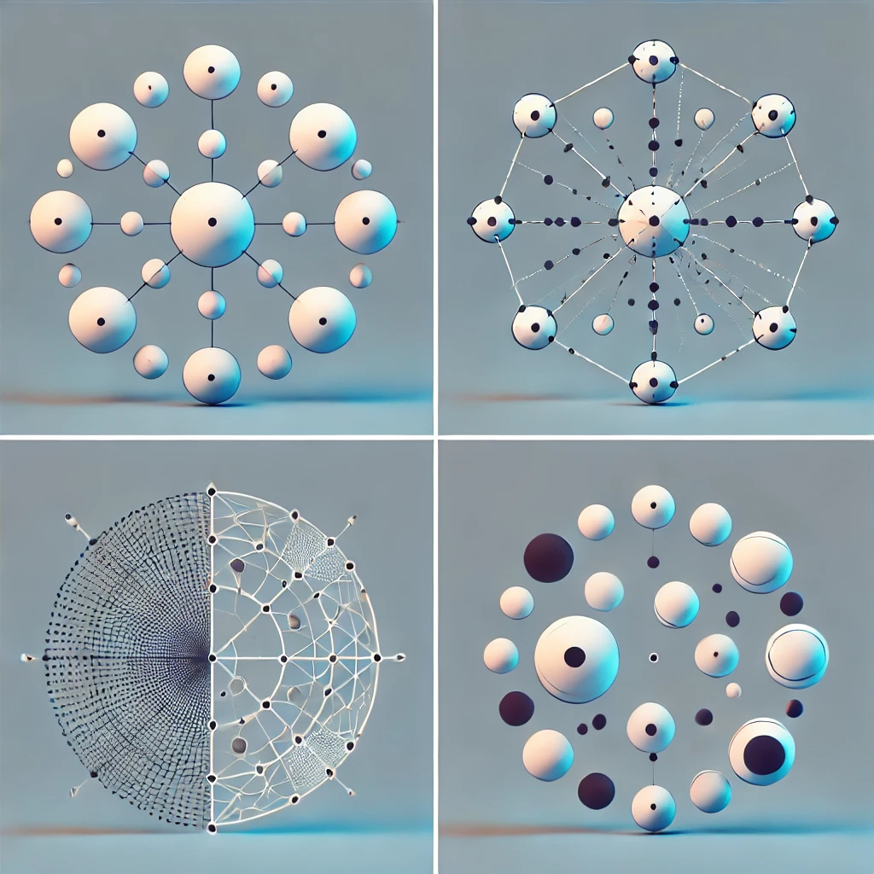
Show a visual of points being classified by different shapes (e.g., line, circle) to represent the idea of shattering.

